Slide 1
Client Side Scripting
Conditional Expressions

Slide 2
Conditional Expressions
Javascript is a sequential programming language
Meaning that every line of code is executed from top to bottom
However there are cases where you don't want every line to execute
You’ll want more control over the way your program works
In programming you will often need to execute certain code when an expression evaluates as true and execute different code when the expression evaluates to false All programming languages enable you to make decisions
They enable the program to follow a certain course of action depending on whether a particular condition has been met or not
This is what gives programming languages their intelligence

Slide 3
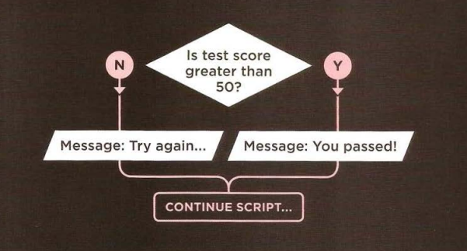
Conditional Expressions
In a flowchart we use the Diamond shape to indicate that a decision needs to be made
Then the code can take different paths
Each path will have different functionality which must be written separately

Slide 4
Conditional Expressions
Conditions are comparisons between variables and data, such as the following:
Is A bigger than B?
Is X equal to Y?
Is M not equal to N?
All of these questions have a yes or a no answer
Therefore, they are boolean-based
Boolean – true or false (0 or 1) result

Slide 5
Conditional Expressions
We can see that the browser needs to make decisions
How can these decision-making capabilities be implemented in your code?
This can be done using the if and switch keywords
These change the flow of the code’s execution depending on whether a condition is true or false
In fact, these are commonly also referred to as control flow statements

Slide 6
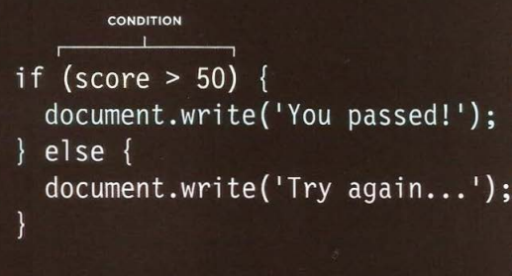
Conditional Expressions The if statment
There are two components to a decision:
An expression is evaluated which returns a value
To make a decision, the code checks the status of your script e.g. Comparing two values
This results in true or false
A conditional statement says what to do in a given situation
If one of the conditions is met, then your code executes a set of statements
Else it does something else
Else, if not handled, the code simply skips that part

Slide 7
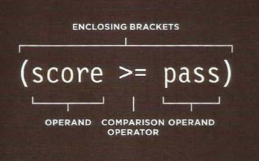
Comparison Operators
In any condition/decision there is usually one operator and two operands
The operands are placed on each side of the operator
They can be values or variables
These values/variables are referred to as the left operand and right operand in such a condition

Slide 8
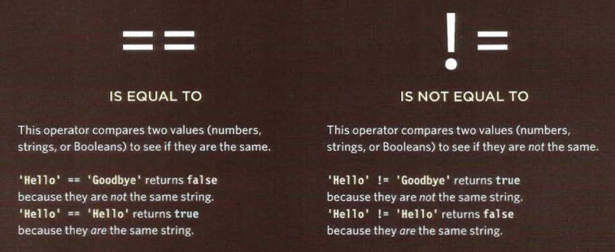
Comparison Operators

Slide 9
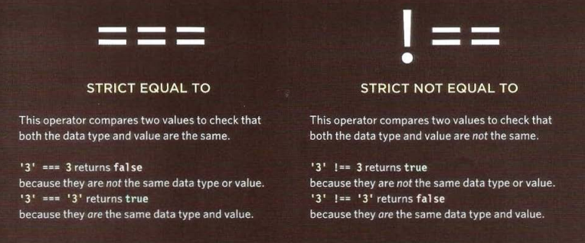
Comparison Operators

Slide 10
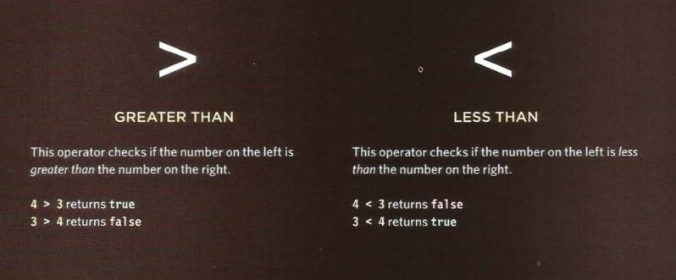
Comparison Operators

Slide 11
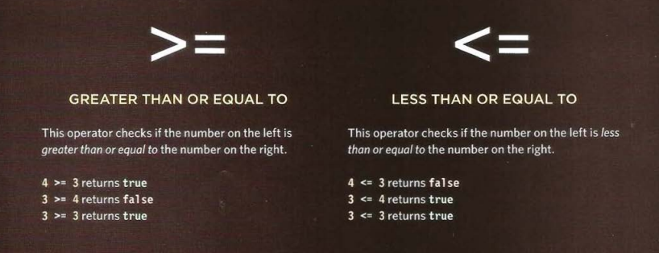
Comparison Operators

Slide 12
Assignment versus Comparison
One very important point to keep in mind is the ease with which the assignment operator (=) and the comparison operator (==) can be mixed up
Remember that the = operator assigns a value to a variable and that the == operator compares the value of two variables
Even when you have this idea clear, it’s amazingly easy to put one equals sign where you meant to put two!!

Slide 13
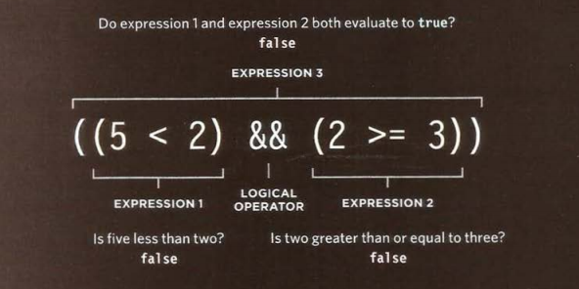
Logical Operators
Comparison operators return true or false values
Logical operators allow you to compare the results of more than one comparison operator

Slide 14
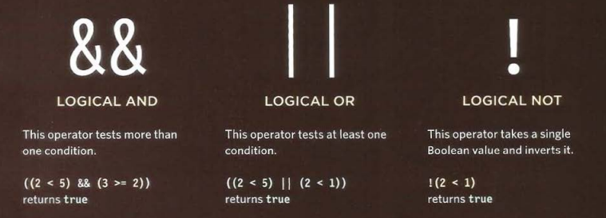
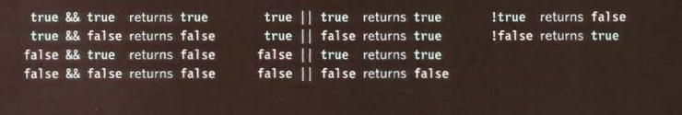
Logical Operators

Slide 15

Practice
Access Moodle and work out Worksheet 7

Slide 16
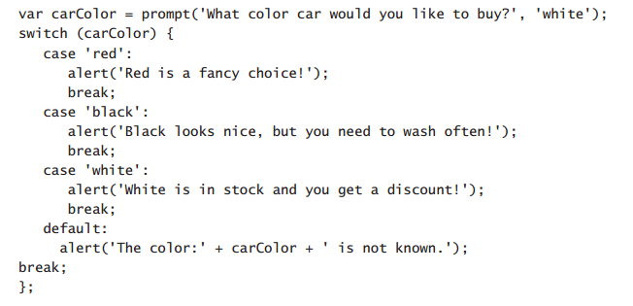
Switch Statments
A switch statement starts with a variable called the switch value
The switch keyword can be used when a single value is to be examined and, based on its value, there could be several outcomes
Each case indicates a possible value for this variable and the code that should run if the variable matches that value.
Consider this example, in which the user is prompted to select a color for the car that he or she is purchasing
Notes:
The default value for the prompt is white. Try it out.

Slide 17
Validation
Validation of user input is probably one of the most common uses of decision making in JavaScript
Data validation is the process of ensuring that a program operates on clean, correct and useful data.
Functions are created for:
Validation rules
Validation constraints
Check routines
These check for correctness, meaningfulness, and security of data that are input to the system
Validation is the process of checking data against a standard or requirement
An example would be checking data entered by a web user (form validation)

Slide 18
Types of Validation
There are different forms of validation:
Data type validation
Range and constraint validation
Code and Cross-reference validation

Slide 19
Data Type Validation
Data type validation verifies that the individual characters provided through user input are consistent with the expected characters of one or more known primitive data types
For example, many database systems allow the specification of the following primitive data types: integer; float (decimal); or string
Similarly, telephone numbers are routinely expected to include the digits and possibly the characters +, -, (, and ) (plus, minus, and parentheses)
A more sophisticated data validation routine would check to see the user had entered a valid country code
A validation process involves two distinct steps:
Validation Check: uses one or more computational rules to determine if the data is valid
Post-Check action: sends feedback to help enforce validation

Slide 20
Simple range and constraint validation
Examines user input for consistency with a minimum/maximum range
Consistency for evaluating a sequence of characters
Consistency for evaluating a pattern in the input
These can be done by using regular expressions

Slide 21
Code and cross-reference validation
Code and cross-reference validation includes tests for data type validation, combined with one or more operations to verify that the user-supplied data is consistent with one or more external rules, requirements, or validity constraints
These additional validity constraints may involve cross-referencing supplied data with a look-up table
For example, a experienced user may enter a well-formed string that matches the specification for a valid e-mail address, but that well-formed string might not actually correspond to a resolvable domain connected to an active e-mail account

Slide 22
Validation Methods
Allowed character checks
Checks if only expected characters are present in a field
A numeric field may only allow the digits 0–9, the decimal point and perhaps a minus sign or commas
A text field such as a personal name might disallow characters such as < and >, as they could be evidence of a markup-based security attack
An e-mail address might require at least one @ sign and various other structural details
Cardinality check
Checks that record has a valid number of related records.
Example if a Customer must have at least one associated Order (Cardinality > 0), if order doesn’t exist for a customer then it must be created
This type of rule can be complicated by additional conditions
For example if contact record in Payroll database is marked as "former employee", then this record must not have any associated salary payments after the date on which employee left organization (Cardinality = 0)

Slide 23
Validation Methods
Check digits
Used for numerical data
An extra digit is added to a number which is calculated from the digits
The computer checks this calculation when data is entered
For example the last digit of an ISBN for a book is a check digit
Consistency checks
Checks fields to ensure data in these fields corresponds
e.g., If Title = "Mr.", then Gender = "M“

Slide 24
Validation Methods
Data type checks
Checks the data type of the input and give an error message if the input data does not match with the chosen data type
e.g., In an input box accepting numeric data, if the letter 'O' was typed instead of the number zero, an error message would appear
File existence check
Checks that a file with a specified name exists
This check is essential for programs that use file handling
Limit check
Unlike range checks, data is checked for one limit only, upper OR lower
e.g., data should not be greater than 2 (<=2)

Slide 25
Validation Methods
Logic check
Checks that an input does not yield a logical error
e.g., an input value should not be 0 when it will divide some other number somewhere in a program
Presence check
Checks that important data is actually present and have not been missed out
e.g., customers may be required to have their telephone numbers listed
Range check
Checks that the data is within a specified range of values
e.g., the month of a person's date of birth should lie between 1 and 12

Slide 26
Validation
Failures or omissions in data validation can lead to:
Data corruption
Security vulnerability
Data validation checks that data is:
Valid
Sensible
Reasonable
Secure

Slide 27
Practice
Access Moodle and work out Worksheet 8

Slide 28
Method Overloading
It is very important to keep in mind that method overloading is not supported by JavaScript
Unlike other Object Oriented Languages, such as C# and Java
In JavaScript, if the interpreter sees/parses two or more functions with the same name, it’ll just consider the last defined function
The previous defined functions would be overwritten

Slide 29
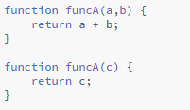
Method Overloading
Consider the following example:
We have two functions having the same name but different arguments: Method overloading in C# or Java

Slide 30
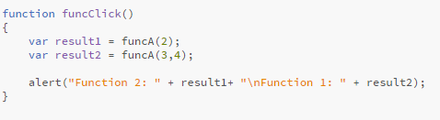
Method Overloading
Now if we create the following function to handle a button click:

Slide 31
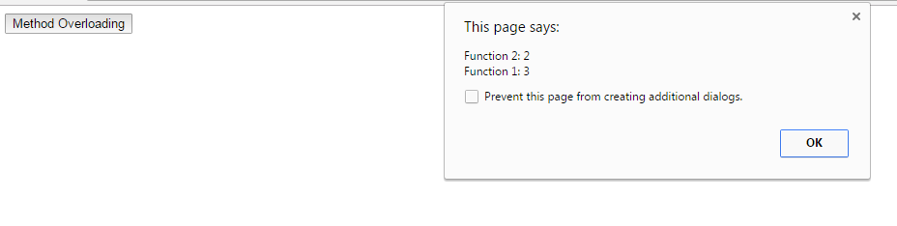
Method Overloading
We would have the following result:

Slide 32
Method Overloading
How can we handle such cases?
As you may have noticed, there was no exception error when calling the same function name and passing different parameters
This is because JavaScript passes parameters in a list of arguments
Therefore, we can check the size of this list and handle the method functionality accordingly

Slide 33
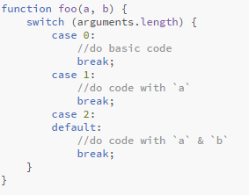
Method Overloading
For example:

Slide 34
Practice
Try out the previous example and solve the issue of funcA()

Slide 35
References
Johnson, G. (2013). Programming in HTML5 with Javascript and CSS3. United States of America: Microsoft Press.
McPeak, J. (2015). Beginning JavaScript, 5th Edition (5 ed.). Wrox.
Haverbeke, M. (2011). Eloquent JavaScript: A Modern Introduction to Programming. (S. Yang, Ed.) San Francisco: William Pollock.
McFarland, D. S. (2014). JavaScript & jQuery (3 ed.). United States of America: O’Reilly Media, Inc.
Duckett, J. (2014). JavaScript and JQuery Interactive Front-End Web Development (1 ed.). Wiley.

